Slide 1


Social Media and the Illusion of Free Speech
This presentation examines the promise versus the reality of online expression. We will explore the tension between the digital public square and private corporate control. Join us as we navigate the evolving global speech landscapes.
Presented by,
1. Sadman Haifj (232-15-119)
2. Fatema Tuj Johura Sohi (2232-15-133)
3. Hossain Ibne Masudul Hoque (232-15-260)
4. Md. Adib Yasir (232-15-697)
5. Nilima Chowdhury Tasnim (232-15-801)

Slide 2
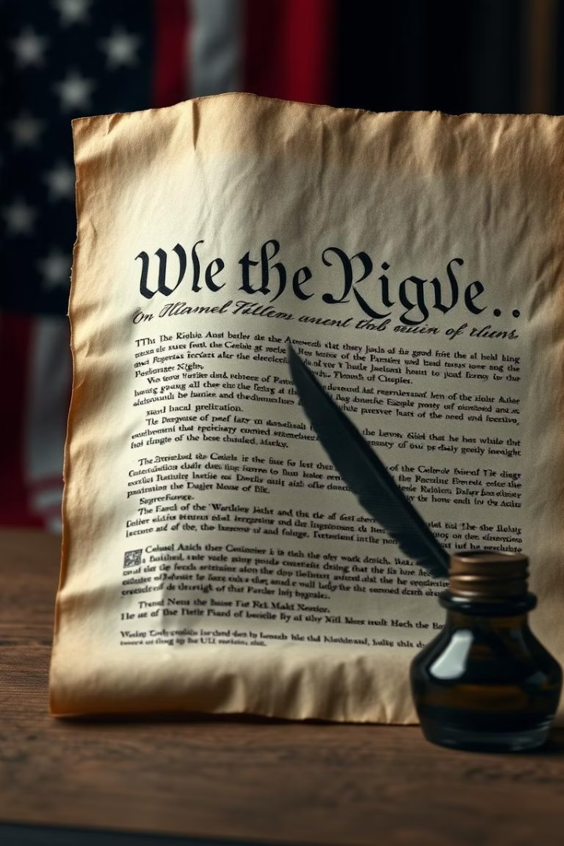



Free Speech: A Foundational Concept
Freedom of speech
Protects citizens from government censorship.
Public Forums
Historically, speech thrived in parks and streets.
Marketplace of Ideas
Diverse ideas compete for public acceptance.
In Bangladesh, freedom of speech is guaranteed under Article 39 of the Constitution, safeguarding expression from government interference. It evolved from public forums, fostering a marketplace where diverse ideas could compete.

Slide 3

Social Media Platforms: Private Actors, Public Forums?
Private Corporations
Global Reach
Operate under their own Terms of Service.
Platforms like Facebook and YouTube have billions of users.
Section 230
Shields platforms from liability for user-generated content.
Social media platforms are private corporations, not government entities. They govern content by their Terms of Service, reaching billions globally. Section 230 protects them from user content liability, while algorithms shape visibility.

Slide 4




Content Moderation: Policies and Practices
ToS Enforcement
1
2
Scale
Millions of pieces of content removed quarterly.
Combatting hate speech and misinformation.
Opacity
Methods
Decision-making can be unclear to users.
4
3
AI, human review, and user reports.
Platforms enforce their Terms of Service against harmful content like hate speech and misinformation. They remove millions of pieces quarterly, using AI, human reviewers, and user reports. The process often lacks transparency, frustrating users.

Slide 5
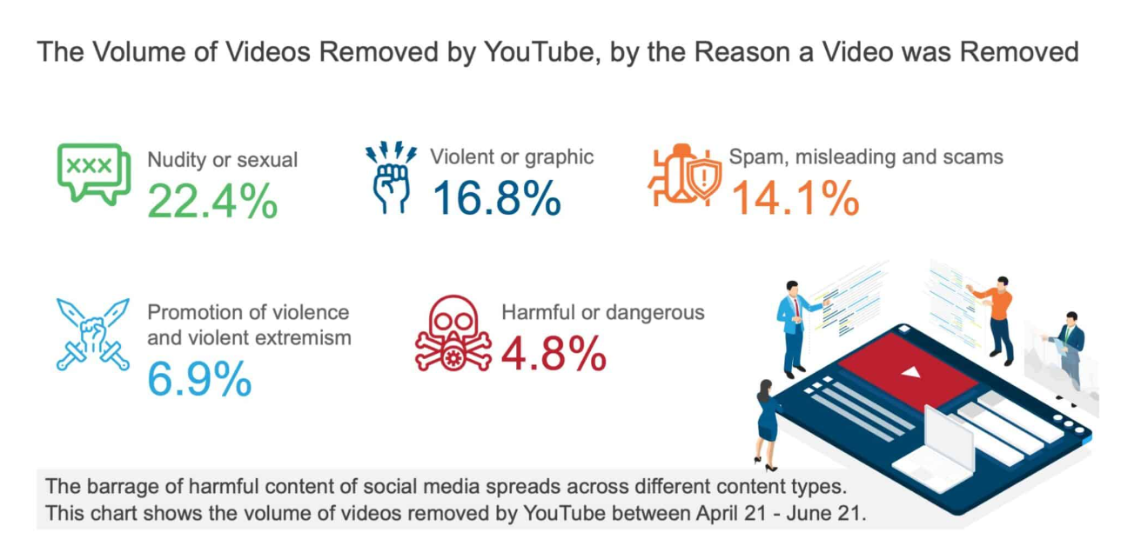
Content Moderation: Statistics

Slide 6
Case Studies: Censorship and Removal Examples
COVID-19 misinformation: False health claims removed by platforms.
Political content: Public figures deplatformed for ToS violations.
Incitement to violence: Content related to the Jan 6th Capitol attack removed.
Hate speech: Antisemitic and racist content removed under guidelines.
Child safety: Millions of CSAM pieces proactively removed.
Platforms actively remove content such as COVID-19 misinformation, political violations, and incitement to violence. They also target hate speech and child sexual abuse material, enforcing their guidelines rigorously.

Slide 7
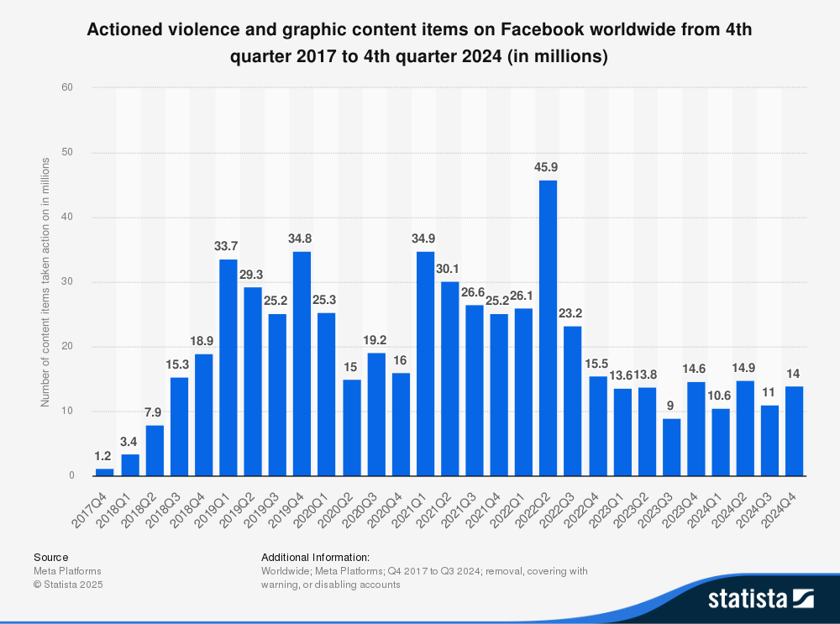
Case Studies: Censorship Statistics

Slide 8
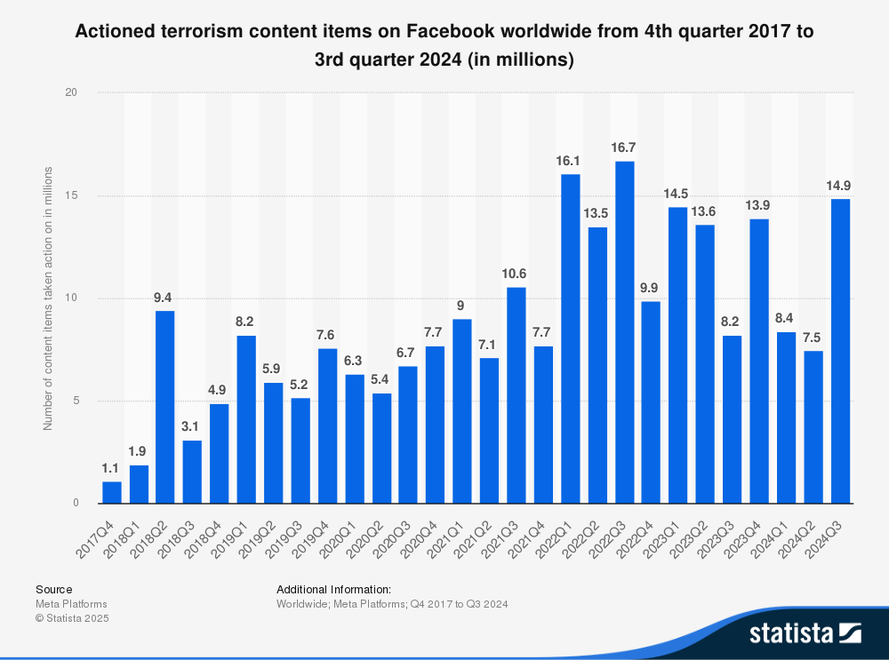
Case Studies: Censorship Statistics

Slide 9
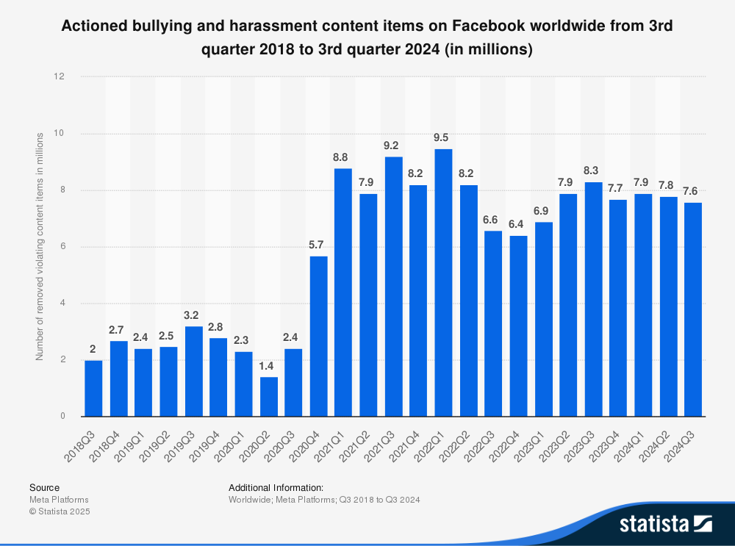
Case Studies: Censorship Statistics

Slide 10





The Illusion Unveiled: Platform Power vs. User Rights
Control
Deplatforming
Shadowbanning
Platforms shape what users see and hear.
Silences individuals from large audiences.
Reduces visibility without notification.
Users often perceive social media as public forums, yet platforms wield significant control. Deplatforming effectively silences voices, while shadowbanning reduces visibility. Corporate interests and ad revenue heavily influence content policies and user experience.

Slide 11
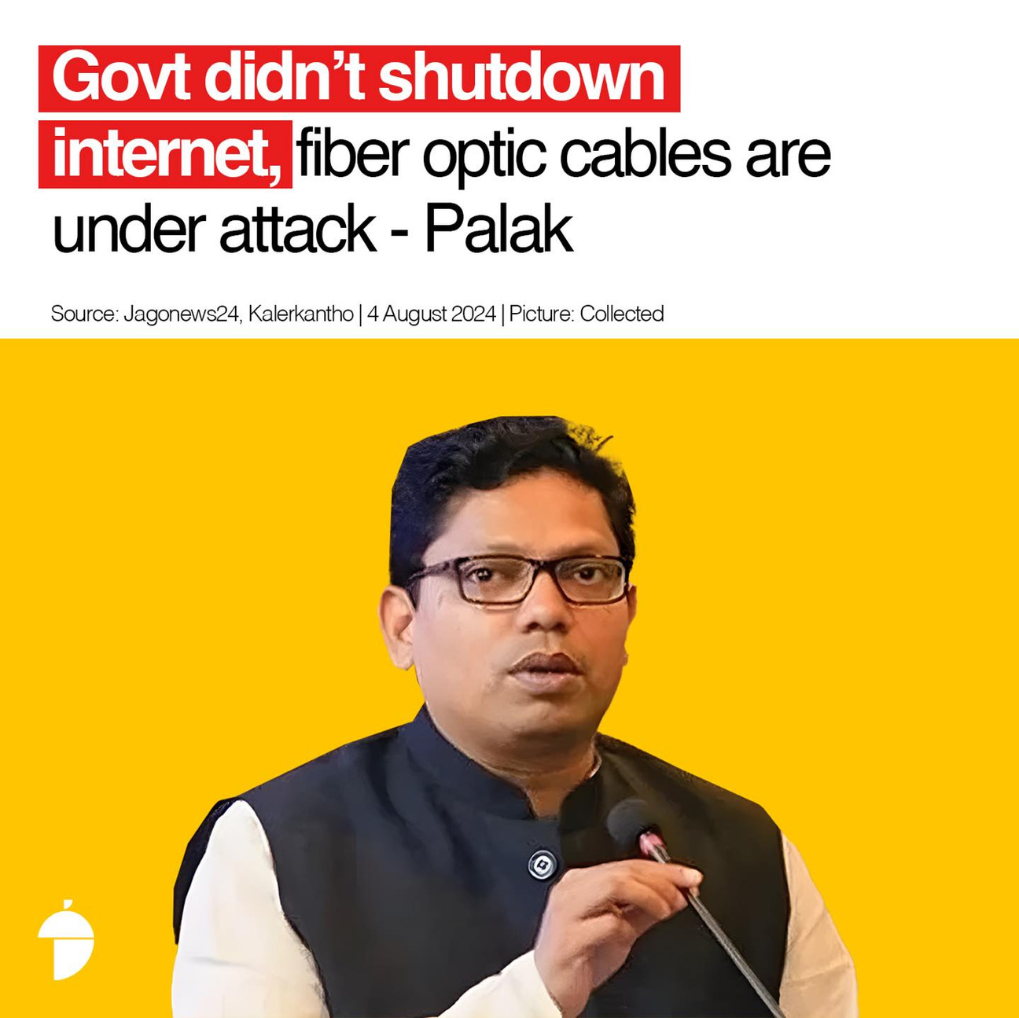
The Illusion Unveiled: Examples
Bangladesh – Quota Reform Movement (June–July 2024)
During widespread student protests against a 30% jobs quota for descendants of freedom fighters, the government imposed severe internet restrictions:
Nationwide mobile and broadband internet shutdown for 5–11 days.
Major social media platforms (Facebook, Instagram, YouTube, WhatsApp, Signal) were blocked for up to 14 days ([freedomhouse.org]).
Activists and journalists were arrested under the Cyber Security Act for social media posts criticizing the quota ([amnestyusa.org]).

Slide 12
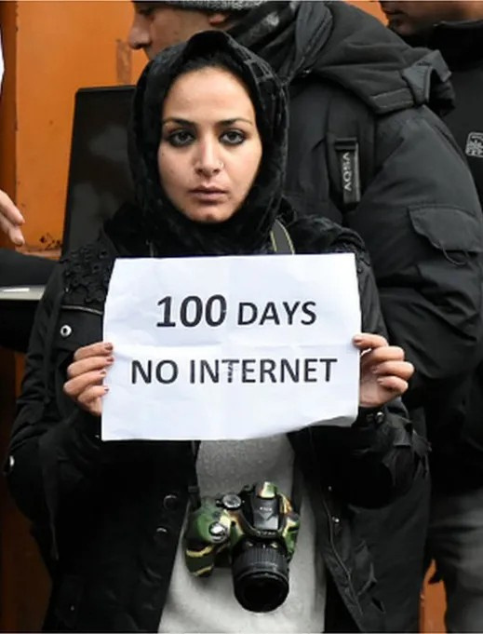
The Illusion Unveiled: Examples
🇮🇳 Kashmir (India-Administered)
Repeated Social Media Shutdowns (2012–2017)
Over 30 internet blackouts occurred between 2012 and 2017 due to unrest and protests.
Popular platforms like WhatsApp, Facebook, Twitter, and Snapchat were frequently blocked.
Over 200 shutdowns were recorded in Kashmir from 2012 to 2020, with 31 in 2016 alone.
Authorities often used 2G throttling, severely limiting online communication and media access.

Slide 13
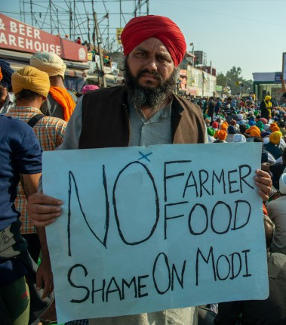
The Illusion Unveiled: Examples
India – Farmers' Protest (2020–2021)
Platform: Twitter, Instagram
Censorship:
Government requested Twitter to remove hundreds of accounts and posts
Blocked hashtags like #FarmersProtest
Reason: Claimed the posts incited violence or were anti-national.
Criticism: Accused of silencing dissent and protecting political interests.

Slide 14
Global Divergence: National Laws vs. Platform Rules
Varying Laws
Platform Navigation
Countries have different legal speech standards.
Platforms must balance global laws and user expectations.
Germany's NetzDG: Strict removal deadlines.
China's Great Firewall: Strict censorship.
India's IT Rules: Faster removals and traceability.
Balancing act: Compliance versus user freedom.
Different countries impose varying legal standards for online speech, often conflicting with platform rules. Platforms must navigate these divergent laws, like Germany's strict NetzDG or China's Great Firewall, while managing user expectations globally.

Slide 15
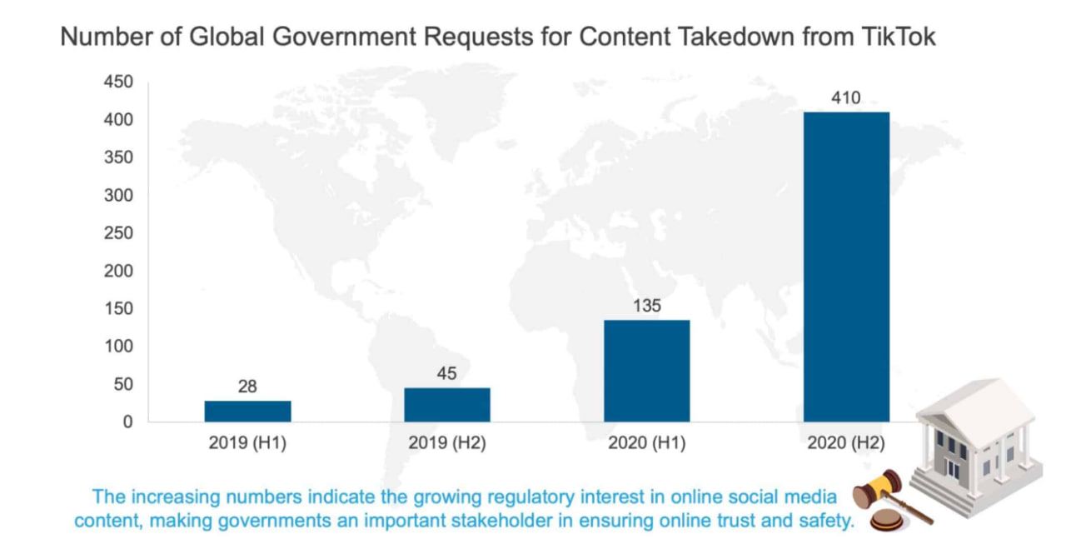
Global Divergence: Statistics

Slide 16




Psychological Impact: Self-Censorship and Echo Chambers
Self-Censorship
Echo Chambers
Diminished Exposure
Fear of moderation leads to muted expression.
Algorithms reinforce existing beliefs.
Less critical thinking, increased polarization.
Fear of moderation leads many users to self-censor. Algorithms create filter bubbles and echo chambers, limiting exposure to diverse viewpoints. This impacts critical thinking, increases polarization, and fosters anxiety over perceived speech suppression.

Slide 17

Ethical Crossroads: Balancing Safety and Expression
Defining Harm
Subjective and culturally sensitive.
Misinformation
Distinguishing from legitimate debate.
Decision-Makers
Platforms, governments, or global consensus?
Balancing user safety with free expression presents ethical dilemmas. Defining "harmful" content is subjective. Distinguishing misinformation from legitimate debate, especially in health, is complex. The critical question remains: who ultimately decides?

Slide 18

Conclusion: Towards a More Transparent Online Discourse
Transparency
Clear, consistent moderation policies needed.
Media Literacy
Empowering users to navigate complexity.
Diverse Alternatives
Promoting open platforms for expression.
Achieving true online free speech requires platform transparency and accountability. Clear, consistent, and appealable moderation policies are crucial. Promoting media literacy will help users navigate complex online environments, fostering a future where expression aligns with democratic values.

